Slide 1

SENG2260 Human-Computer Interaction
Introduction to HCI
All images in this presentation are either licenced or labelled for reuse on Google Images.

Slide 2
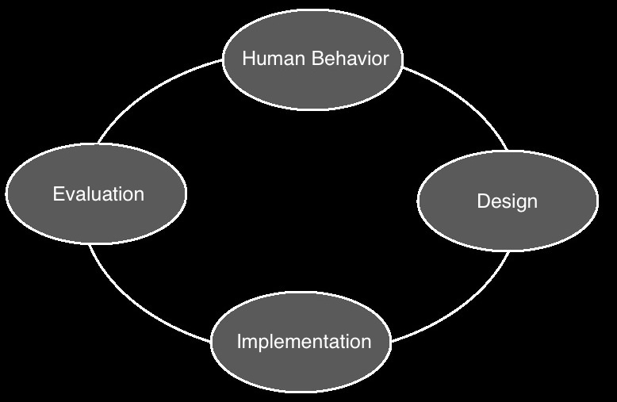
What is HCI
ACM HCI special interest group define HCI as:
‘The discipline concerned with the design, evaluation and implementation of interactive computer systems for human use and with the study of major phenomena surrounding them’

Slide 3
What is HCI²
The study of interaction between people and computer-based systems
Concerned with the physical, psychological and theoretical aspects of this process
Human-computer interaction is about designing computer systems that support people so that they can carry out their activities productively and safely

Slide 4
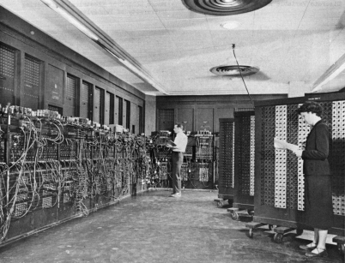
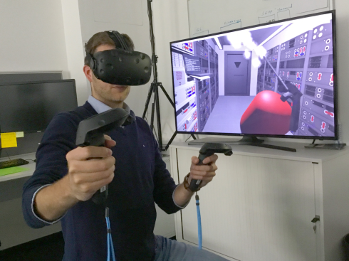
History of HCI
Notes:
ENIAC + HTC VIVE VR

Slide 5
History of HCI
A history :
Engineer's designed hardware systems for engineers
Late 70’s/80’s – Monitors/VDUs
New concept – the user interface
I/O feedback loop – displays/keyboards
Graphical user interfaces (GUI)
Design of WIMPs
Computer scientist, psychologists
Mid 80’s – Next generation systems
Multimedia, information visualisation, VR, speech recognition
Education/training systems - new skills for developers
Developmental psychologists, training experts …

Slide 6
History of HCI²
The 90’s – Interface at the work setting
Networking, mobile computing, infrared sensing …
Integration of computers into everyday society
Enhancements by technology
Mid 90’s – Multidisciplinary design
New needs for the new technologies
Specialists from media, design, film, narrative …
Meeting diverse user needs
00’s+ – Interface becomes pervasive and virtual
Radio-frequency tags, Bluetooth technology, large interactive screens, embedded technology, augmented reality, virtual reality, brain-computer interfaces …
New demands on interaction and HCI design

Slide 7
History of HCI³
Led to the formation of
Ergonomics society
Human factors
The field has taken many guises
Man-machine interaction (MMI)
Computer-human interaction (CHI)
Human-computer interaction (HCI)
Objectives of HCI are
“to provide an understanding of both the human user and the computer system, in an effort to make interactions between the two easier and more satisfying …..”
“… however the emphasis should always be on the user”
Goals are not always achieved

Slide 8
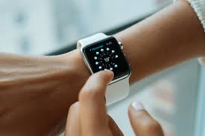
Human-Computer Interaction
User
individual user, a group of users working together or a sequence of users in an organisation dealing with some part of a process or task
Computer
technology ranging from desktop to a large scale systems, or control/embedded systems
Interaction
communication between the user and computer in a direct or indirect manner

Slide 9

What is involved
Study of humans using interfaces
Development of new applications/systems to support user’s activities
Development of new devices and tools for users
Develop usable products
Easy to learn
Effective to use
Provide and enjoyable and satisfying experience
Notes:
AR from London eye

Slide 10
What is Involved²
HCI is an interdisciplinary subject
Range of topics: psychology, ergonomics, sociology
Computer science and system design are the central concerns
However, it is not possible to design effective interactive systems from one discipline in isolation

Slide 11
Disciplines contributing to HCI
Cognitive psychology
Linguistics
Computer science
AI
Anthropology
Philosophy
HCI
Engineering
Sociology
Social & organisational
psychology
Ergonomics and human
factors
Design

Slide 12
Why should you be concerned with HCI
ICT professionals
Oversee the development of new interactive systems
Need to know how to make these systems usable
Oversee the introduction of new systems into an organisation
Need to be able to evaluate the usability of bespoke and COTS systems
Good design involves understanding how users interact with computers and enabling users to do so effectively

Slide 13
Why should you be concerned with HCI²
Increasing a matter of law
National health and safety standards constrain employers to provide their workforce with usable computer systems
EC directive 90/270/EEC – when designing, selecting, commissioning or modifying software
Is suitable to task
Is easy to use and adaptable to the user’s knowledge and experience
It provides feedback on performance
It displays information in a format and at a pace that is adapted to the user
It confirms to the “principles of software ergonomics”
Designers and employers cannot afford to ignore the user

Slide 14
Factors in HCI
Organisational factors
Environmental factors
Health & safety
The user
Comfort
User interface
Task factors
Constraints
System functionality
Productivity factors
Notes:
Organisational = training, job design politics, roles, work organisaiton
environmental - noise, training, lighting, ventilation
health and safety - stress, headaches, musculo-skeletal disorders
the user (cognitive processes and capabilities) motivation, enjoyment, satisfaction, personality, experience level
task factors - easy, complex, novel, task allocation, repetitieve, monitoring, skills, components
constraints, cost, timesscales budget, staff, equipment, building structure
system functionality - hardware, software, application
productivity factors - increase output, increase quality, decrease costs, decrease errors, decrease labor requirements, decrease production time, increase creative and innovative ideas leading to new products.

Slide 15
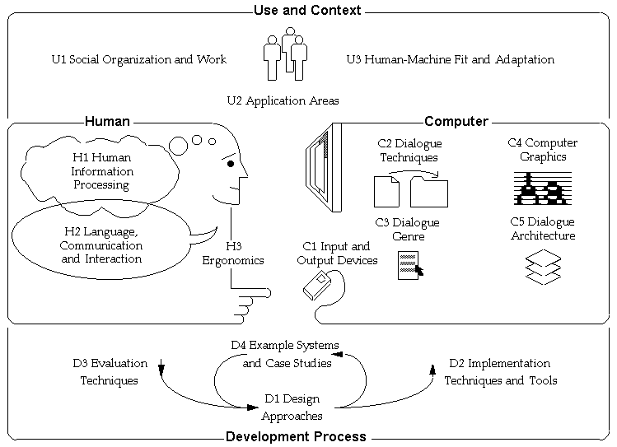

Slide 16
Problems with software
Software has been blamed for:
Excessive and unwanted share dealing on the world’s stock market
Errors in the dosages given to patents receiving radiation therapy
Erratic behavior of military and civil aircraft
Difficulties in controlling nuclear power plants during some system failures
Delays in dispatching ambulances to accidents

Slide 17
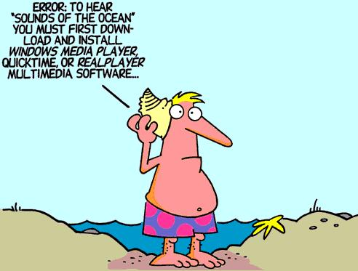
Avoiding problematic design
Take into account
Who the users are
What activities are being carried out
Where the interaction is taking place

Slide 18
Avoiding problematic design
Take into account
Who the users are
What activities are being carried out
Where the interaction is taking place
Optimise the interactions users have with a system
Such that they match the users’ activities and needs

Slide 19
Three “use” words
Must be true for a product to be successful
Useful
Accomplish what is required: play music, cook dinner, format a document
Usable
Do it easily and naturally, without danger of error etc
Used
Make people want to use it, be attractive, engaging, fun etc

Slide 20
Principles for supporting HCI
Taking into account what people are good and bad at
Considering what might help people with the way they currently do things
Thinking through what might provide quality user experiences
Listening to what people want and getting them involved in design
Using tried and tested user-based techniques during the design process

Slide 21


Science or craft?
Does it involve artistic skill and fortuitous insight or reasoned methodical science?
Bit of both
Artistically pleasing and capable of fulfilling the tasks required
The combination of science and art into a successful whole
Innovative ideas lead to more usable systems
Need to understand not only that they work but how and why they work
Creative flow underpinned with science
Scientific method accelerated by artistic insight

Slide 22
You should now...
Be able to define what is HCI
Be able to show how the factors of HCI interrelate
Know the disciplines that contribute to HCI and the impact that each has
Be able to list several problems with software development that HCI research is trying to address

